Slide 1
Building Name: Room Number
Department Name:
General Hazards / Restrictions (insert appropriate pictographs) | General Hazards and Area Restriction Statements (Insert appropriate hazard / restriction descriptions) Compressed Gases
Primary Area Contact: | Primary Contact Name (xxx) xxx-xxxx (Main Phone) / (xxx) xxx-xxxx (After Hours)
Secondary Area Contact | Secondary Contact Name (xxx) xxx-xxxx (Main Phone) / (xxx) xxx-xxxx (After Hours)
Department / Division Head | Department / Division Head Name (xxx) xxx-xxxx (Main Phone)
Facility / Building Safety Contact | Safety Contact Name (575) 646-3327 (Office) / (575) 312-6649 (Cell – After Hours)
NMSU Environmental Health & Safety: | (575) 646-3327 (Main Office) (575) 646-3311 (NMSU Emergency Dispatch – After Hours)
Fire/Police/Ambulance: | 911

Slide 2
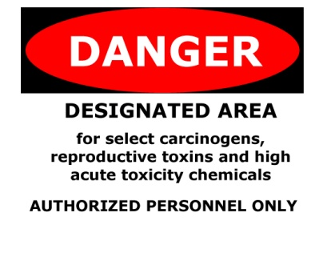
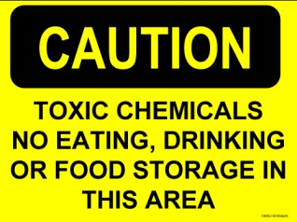
Pictograph – Use as needed on door sign

Slide 3
Pictograph – Use as needed on door sign

Slide 4
GHS Pictogram Guide

